Slide 1
Data Analytics
Solution
Architectures
Shrikesh Pattni as of 06/2022

Slide 2
Solution Architecture - Options
Summary
Type
Risk
Tools Involved
Complexity
Value Add
Execution
Stakeholders
1
Self-service
Dataflows
Great for starting out, ideally for business users to get familiarity
Quick execution means quicker time to see results
Potentially many iterations of the same report
Less confusion, person builds as they see fit
Repetition of work, leads to multiple versions
Leads to clutter overtime, no governance strategy
Poor models>>poor reports>>no “value” impact
No taxonomy, lack of KPI definition in business
Excel
Power Query
PBI Desktop
PBI Workspace
Low
Low
High
BA/FA/
Data Analyst
2
Data Warehouse
Disciplined with flexibility involved in 1 semantic date model
Highly performant, enterprise level. MPP architecture
Understanding data definitions and centralising core KPIs
Best for normalising the data structures (local/global level)
Lacks data flexibility. Not great for unstructured/semi structured data
High implementation and maintenance cost. (Taxonomy)
Performance is overlooked as data volume grow
All 1 +
SQL Server
Tabular Editor
PBI Capacity
Mid
High
High
Data/BI Engineer
Data Architect
Data Stewards/Owners
3
Golden Dataset
Used for extremely large complex dataset in multi tier architecture
Great with working with multiple users doing updates to 1 model
Can integrate with Azure Devops, works for Pro and Premium
Allows for doing versioning control on 1 source file, MODEL.BIM
You have to create a new way of working so the team when updates are being made onto master file
Update can be merged onto wrong branch
Causes technical debt/confusion for new employees coming into project
2 +
VS & GIT
Azure Devops
Analysis Service
High
High
Low
Data/BI Engineer
Product Owner
SCRUM Master
4
Datalake
Data Lake gives business users immediate access to all data.
Data Lake removes the need for an IT domination culture for business users, and reduces long-term cost of ownership
Non-ACID compliance: updates and deletes are complex operations
Reduces long-term cost of ownership
Enterprise level implementation. Users, from various departments, may be scattered around the globe can have flexible access to the data
If not properly managed, data lakes can become disorganized, making it hard to connect them with business intelligence and analytics tools
Unknown area of Data Processing
Data lakes lack of data consistency makes it difficult to enforce data reliability, security and governance
Unstructured Data may lead to Ungoverned and Unusable Data, Disparate and Complex Tools
3+
Cloud Azure/AWS/Goggle
Low
Mid
High
Data/BI Engineer
Cloud Engineer
Product Owner
SCRUM Master
5
Lakehouse
A new data architecture that combines the data lakes and data warehouse. Solution is built on Bronze, Silver, Gold data curation
ACID-compliant to ensure consistency as multiple parties concurrently read or write data
Take a decentralized approach to store and process data
Because it accommodates all data formats, it can be challenging to implement proper data security and governance policies to cater to sensitive data types.
It’s still a relatively new and immature technology
3
Mid
High
Mid
Data/BI Engineer
Cloud Architect
Product Owner
6
Serverless
Serverless computing runs on servers, but those servers are managed by cloud service providers, i.e. Azure Synapse.
Applications built on serverless architecture can be scaled endlessly and automatically. No worrying about a spike in traffic bringing down your site or causing poor performance
Because it accommodates all data formats, it can be challenging to implement proper data security and governance policies to cater to sensitive data types.
It’s still a relatively new and immature technology
3
Mid
High
Mid
Data/BI Engineer
Cloud Architect
Product Owner
7
DataMart's
Data Warehousing for business users
Uses Azure SQL built inside Power BI at scale (500TB) of loaded data.
Uses a No Code, Low Code, by the use Power Query, (No pipelines)
DataMart's are recommended for customers who need, decentralized data ownership as a semantic layer at scale.
(not a risk), but only offered on Premium Gen 2 licensing, (PPU/PPC)
Relatively new to Power BI ecosystem
Data Governance, strategy is an absolute must as it’s centralised datasets for departments
3
Mid
High
Mid
Technical BA
Data/BI Engineer
Cloud Architect
Product Owner
Shrikesh Pattni as of 08/2022

Slide 3
Solution Design/Architecture - Options
Data Flow
Power BI Model
Power BI Reports
Self-service
Dataflows+
Extract
Load
Transform
Model
Visualise
Governance
SQL or AAS or Power BI Premium
Power BI Model
Power BI Reports
Data Warehouse
Corporate BI
Extract
Load
Transform
Model
Visualise
Governance
SQL
Model.BIM
Power BI Model
Power BI Reports
Golden Dataset
Extract
Load
Transform
Model
Visualise
Governance
Datalake
Data Factory/Synapse
Power BI Model
Power BI Reports
Datalake
Extract
Load
Transform
Model
Visualise
Governance
Data Warehouse & Lakehouse
SQL
Power BI Model
Power BI Reports
Lakehouse
Approach
Extract
Load
Transform
Model
Visualise
Governance
Azure Synapse
Power BI Model
Power BI Reports
Serverless
Extract
Load
Transform
Model
Visualise
Governance
Data Flow
Datamart - Azure (On Power BI)
Power BI Model
Power BI Reports
Datamart
Extract
Load
Transform
Model
Visualise
Governance

Slide 4
Data Analytics
Key stages of the analytics process
Shrikesh Pattni as of 08/2022

Slide 5
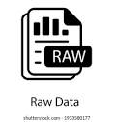
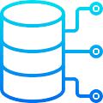




Source
the raw data
Ingest
data sets
Validate
Data assets
Store
for access
Deliver for consumption
Consume
for analytic
Metadata
Raw Data
Validation/
Unharmonized
Data Rules
Semi-Harmonisation
Metadata/ETL
Harmonisation
Source/ETL
Model Building
CI/CD Model Deployment
BEAM Methodology
Shrikesh Pattni as of 08/2022

Slide 6


(What are the key stages and phases of analytics solution delivery 1.2
Data Providers
Transactional Data
Ingested
Process
Curation
Derived Layer
Data Analytics/Insights
Data Landing Zone
Master Data Management
Semantic Layer
Blob Storage
SQL DW/Azure Synapse
DevOps/Data Visualisation
Logs (unstructured)
Data Taxonomy
Repo Version
Centralised Data Model
Star/Snowflake
Hold Raw Data
Schemas Creation
Table 1
CTE/View
R1
Media (unstructured)
Surrogate Dimension
Table 2
CTE/View
R2
Code-free data transformation and ingestion from 90+ data integration connectors
Dimension
Table 3
CTE/View
R3
Cleansed Filtered remove blanks
Files (unstructured)
Facts
Table 4
CTE/View
R4
Aggregations
R5
Business/ custom apps (structured)
Stores Aggregates at different levels
Contingent Facts
R6
Store – Azure Dataa Lake Storage
Metadata
Raw Data
Validation/
Unharmonized
Data Rules
Semi-Harmonisation
Metadata/ETL
Harmonisation
Source/ETL
Model Building
CI/CD Model Deployment
BEAM Methodology
Enterprise Data Fabric
Data Quality
Data Value Chain
Shrikesh Pattni as of 08/2022

Slide 7
Data producer (internal or external role)
Data producer (internal or external role)
Responsible for the day-to-day creation, enrichment, distribution and (if appropriate) deletion of master data. They will defer to the Data stewards for any activities that fall outside existing processes or conflicts
Data steward (internal role)
Data steward (internal role)
Responsible for day-to-day activities required to support the Data Governance decisions agreed and directed by the respective Data Owners in their pre-defined data areas. They are responsible for executing, facilitating and coordinating the implementation of standards, priorities and processes to enable high quality data
Data owner (internal role)
Senior individuals with dedicated ownership for a master data domain, and in-depth insights of the overall business strategy in their data remit.
Accountable for defining the applicable data standards and ensuring global business decisions agreed by the Data Council are upheld.
By liaising with a team of Data Stewards, they are empowered to steer and drive top quality data
Data/BI Architects
Data architect is an expert who formulates the organizational data strategy, including standards of data quality, the flow of data within the organization, and security of data. It's the vision of this data management professional that converts business requirements into technical requirements
Shrikesh Pattni as of 08/2022

Slide 8
Data Analytics
Common Challenges
Shrikesh Pattni as of 08/2022

Slide 9
Data Silos
Performance Constraints
Solution Complexity
Escalating Costs
Global structures don’t meet the requirements of local markets, which has resulted in the creation of multiple overlapping datasets
Data trust is lost at source because of lack of validation between unharmonized and harmonized data
communication issues and inconsistent reporting
Mitigation steps:
Better communication to mitigate
Complex words, (simple English)
Better Alignment, (correct team)
Data Owner role
Structure in teams
Scale of data volumes not fit for technology
Data is not normalized enough at source
Report refreshes takes long because it has not been built with performance In mind (Power BI)
Mitigation steps:
Build performance artefacts at source
Normalise data structure (regardless of tool)
Sharing capturing knowledge
Lessons learnt (log)
Processes related to our master data activities often require a repetitive high manual effort
Too much overlapping voices can result in abstract end goals, and therefore some task more complicated.
Project/Team alignment
Incorrectly built Data Models (i.e. M2M relationships between star/snowflake schema)
Mitigation steps:
Building data models correctly
Tool agnostic mindset
Lack, or no use of a data dictionary
Managing expectations based on what can be built, based on what we have.
Tradition On-Prem, increased in maintenance
Lack of all 3 (on left) increase in cost
Project takes longer, more cost
Mitigation steps:
Better outputs on doing Proof of Value
Getting a forecast cost before the project
Understanding Cost vs Benefits
Better levels of risk assessment
Robust Data Governance Framework
Shrikesh Pattni as of 08/2022

Slide 10
Data Analytics
Wireframes
Shrikesh Pattni as of 08/2022

Slide 11






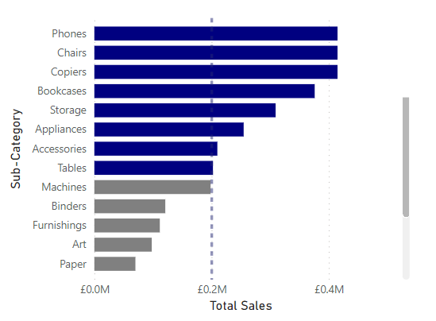
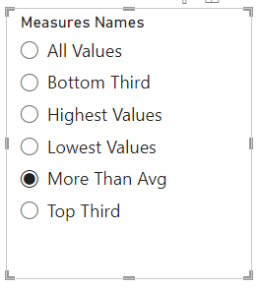
Reset Filter👇🏻
1st Section
👈🏻Navigation here
Show Dash Infor 👆🏻
2nd Section
Filters here 👉🏻
Show Actuals
Show PY
Show SPLY
Show MA
Show Targets
3rd Section
Vs Target
2.4% ⬆
Vs Target
0.8% ⬆
Vs Target
2.9% ⬇
Vs Target
1.1% ⬆
Vs Target
10.6% ⬇
Vs Target
0.3% ⬇
Vs Target
5.9% ⬆
Vs Target
2.4% ⬆
Trending/Benching view . Multiple Views👇🏻
Trending/Benching view . Multiple Views👇🏻
4th Section

Slide 12

1st Section
2nd Section
Descriptive Text goes here only
Show Actuals
Show PY
Show SPLY
Show MA
Show Targets
3rd Section
Vs Target
2.4% ⬆
Vs Target
0.8% ⬆
Vs Target
2.9% ⬇
Vs Target
1.1% ⬆
Vs Target
10.6% ⬇
Vs Target
0.3% ⬇
Vs Target
5.9% ⬆
Vs Target
2.4% ⬆
Trending/Benching view . Multiple Views👇🏻
Trending/Benching view . Multiple Views👇🏻
4th Section

Slide 13





1st Section
Descriptive Text goes here only
Home Page
2nd Section
Add Filters
Show Actuals
Show PY
Show SPLY
Show MA
Show Targets
Data source
3rd Section
Page Navigation
Ask a Question!
Vs Target
2.4% ⬆
Vs Target
0.8% ⬆
Vs Target
2.9% ⬇
Vs Target
1.1% ⬆
Vs Target
10.6% ⬇
Vs Target
0.3% ⬇
Vs Target
5.9% ⬆
Vs Target
2.4% ⬆
Detail Scorecard
Trending/Benching view . Multiple Views👇🏻
Trending/Benching view . Multiple Views👇🏻
4th Section

Slide 14
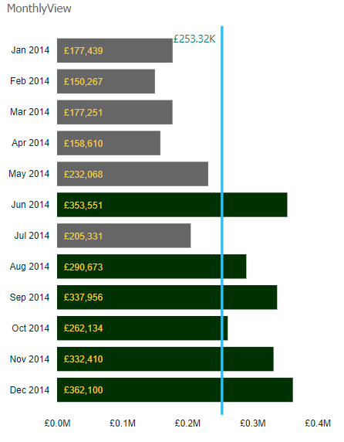
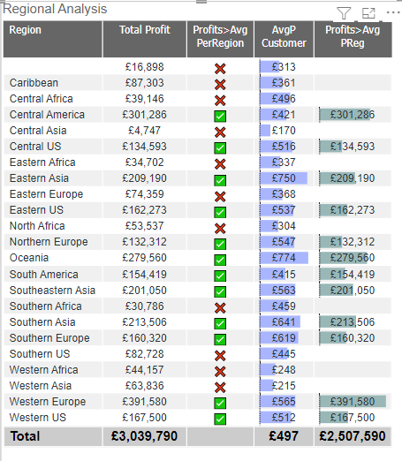
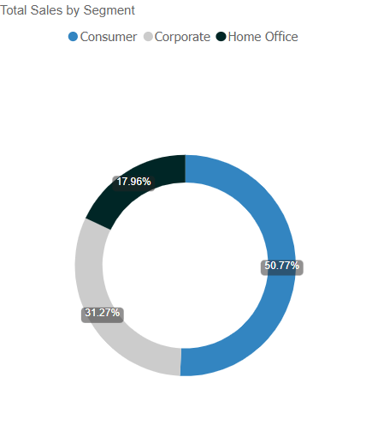
Reset Filter👇🏻
1st Section
👈🏻Navigation here
Show Dash Infor 👆🏻
Filters here 👉🏻
2nd Section
Trending/Benching view 👇🏻
Tabular view 👇🏻
High Level view 👇🏻
3rd Section
4th Section

Slide 15
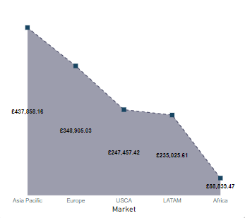
Reset Filter👇🏻
1st Section
👈🏻Navigation here
Show Dash Infor 👆🏻
Filters here 👉🏻
2nd Section
3rd Section

